Slide 1
Working Memory and Autism

Slide 2
Why conduct this research?
By assessing Working Memory (WM) at an early age in school, children with such difficulties can be identified and given the opportunity for early intervention.
A review of the literature has indicated that WM has been studied extensively in the typically developing population but there has been little research with the population of autism.

Slide 3
Background - Research Study
Pilot Study
56 children with and without autism.
Aims of the research:
To examine whether children with autism have difficulties with WM compared to their typically developing peers.
Ethical Approval from Office for Research Ethics Committees Northern Ireland (ORECNI) – August 2011
Dr Tracy Packiam Alloway

Slide 4
Tests
Verbal Short term
Digit Recall
Verbal Working Memory
Listening Recall
Visuo-Spatial Short term
Dot Matrix
Visuo-Spatial Working Memory
Spatial Recall
www.pearson-uk.com/AWMA

Slide 5
4 Assessments & Informal Observations

Slide 6
Verbal short-term memory: Digit recall
839251
839251
Hear a sequence of digits and attempts to recall each sequence in the correct order.
Block of 1 number to a block of 9 numbers.
To receive a correct score for each trial, each number must be recalled in the correct order.
www.pearson-uk.com/AWMA
Notes:
6

Slide 7
Digit Recall –Informal Observations
Understanding by both groups.
Despite the task being dependent on auditory processing, this is a task which is regularly performed in class.
apps on their computers and mobile phones.
Children from both groups appeared to have developed the skills of recalling digits.
Some children with autism spent a great deal of time between hearing the digits and recalling them.
They were given the time required to process what they had heard.
Other children with autism found it difficult to focus and concentrate after doing practise trial.
Given a break if required.

Slide 8
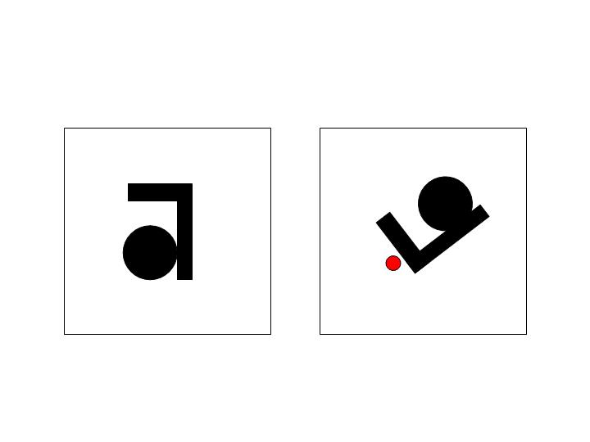
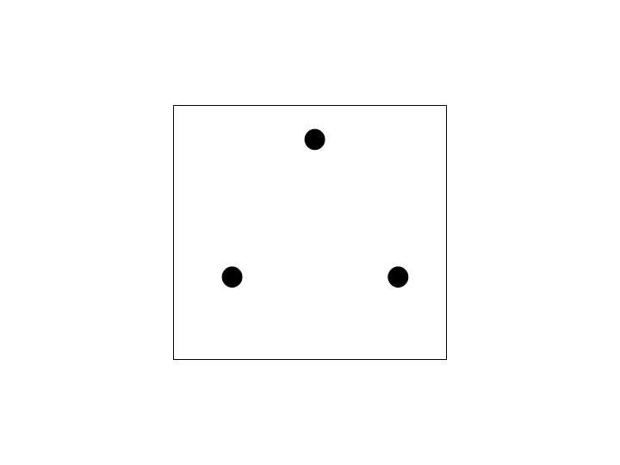
Visual-spatial working memory: Spatial Recall
Same/ different
Two shapes, shape on the right has a red dot above it.
Identify whether the shape on the right is same or opposite.
Shape with the red dot could be rotated.
End of each trial, recall the location of each red dot on the shape, in the correct order, or by pointing to a picture with three possible positions marked.
Block 1 set up shapes increasing up to Block 7 sets of shapes
Score for correctly identifying whether the shape with the red dot is the same or the opposite of the shape on the left. The Processing score.
Also receive a score for correctly recalling the position of each dot in sequence.
www.pearson-uk.com/AWMA

Slide 9
Spatial Recall – Informal observations
Obvious differences between the control group (typically developing) and the experimental group (autism).
Children with autism found this task more difficult than their peers.
Two step process -Dependent on auditory processing skills.
Used the practice time to gain understanding-lengthy-lost focus
Children with autism were given more time to process instructions
Focused on voice over -Repeated “Even though it moved around”
Focused on the shape –”It looks like an “Axe”
Said Not opposite instead of same
Gave automatic responses without focusing on the shape

Slide 10
Spatial Recall – Informal observations
Overload of information- instructions lengthy.
As tasks became more complex informal observations showed that some children found it more difficult to engage in the task at hand.
Strategies
Hands on knees , feet firmly on floor (visuals)
Explained using visual cues same and opposite e.g. books, pencils, rulers
Repeated voice over instructions slowly using First and Then

Slide 11
Verbal working memory: Listening Recall
“chairs lay eggs “
“bananas have teeth”
false
false
eggs, teeth
Series of individual sentences -true or false. Recall the final word of each sentence, in the correct order.
Block of 1 sentence and increases to a block of 6 sentences.
Two scores. A score for responding true or false correctly- Processing score. A score for recalling the final word in each sentence correctly.
www.pearson-uk.com/AWMA
Notes:
11

Slide 12
Listening Recall- Informal observations
Children with autism found this task more difficult.
Dependent on auditory skills.
Fidget, swinging on chair, yawn – less focused
Two step process
Children with autism required more time to process the information given
Instructions repeated
Some children would have grasped the concept when 1 sentence was called out but when they had to remember the last word of 2 sentences, proved more difficult.

Slide 13
Listening Recall- Informal observations
For some children with Autism some sentences were amusing more memorable for example “Bicycles have ears,” “Mice play music”, “bananas live in water”.
Children with Autism gave detailed responses to sentences for example …“Glass is sharp”
Explanation glass could be sharp when it is broken but not sharp when it was not broken, therefore the statement could be both true and false.
TD children appeared more aware of their successes- raising a hand in the air saying yes!

Slide 14
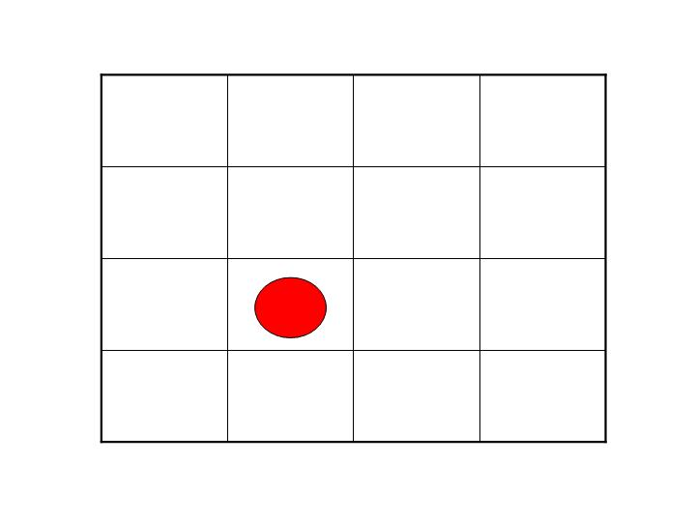
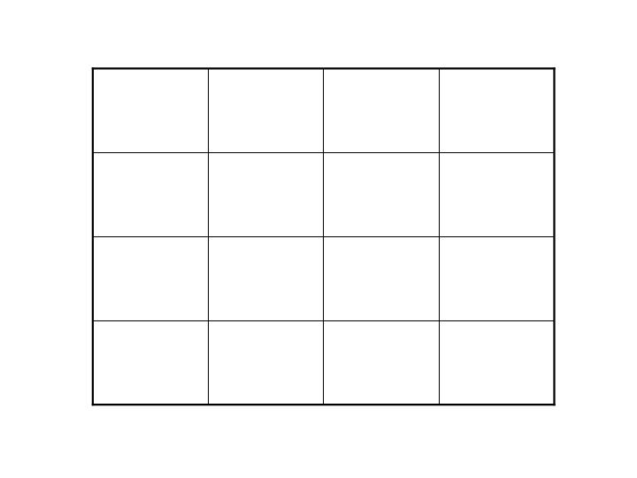
Visual-spatial short-term: Dot matrix
The individual is shown the position of a red dot in a serious of four by four matrices and attempts to recall the position by tapping the squares in the computer screen.
Test trials
The test begins with a block of 1 dot and increases to a block of 9 dots.
Scores
In order for an individual to receive a correct score for each trial, each dot must be recalled in the correct order.

Slide 15
Dot Matrix-Informal observations
This is a visual memory test.
Change in body language
Sat closer to the screen, appeared more focused.
Performance of some of the children with autism was not dissimilar to their same-aged typically developing peers.
Visual
More a game
Computers and phones

Slide 16
Results

Slide 17
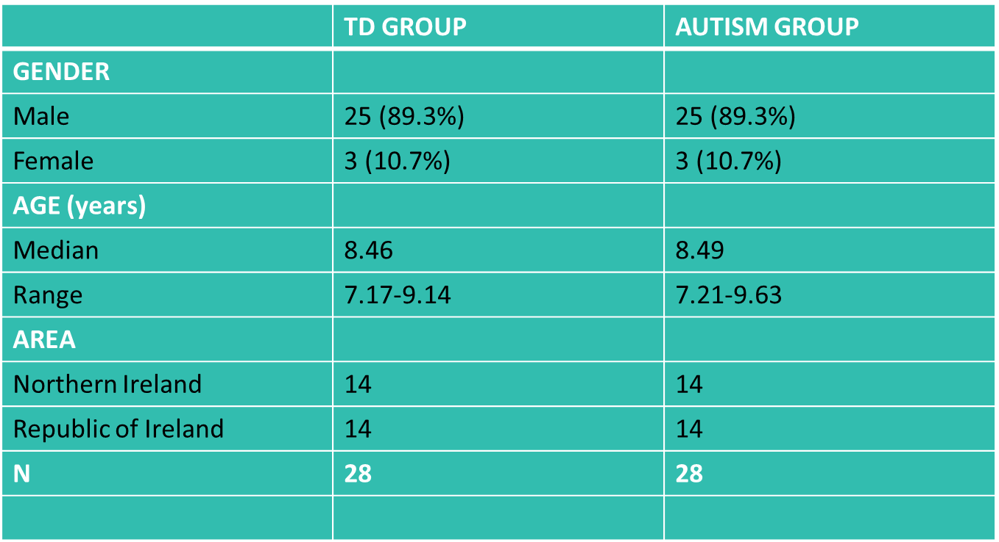
Demographic Profile

Slide 18
Analysis
The results were analysed using both a multivariate analysis of variance (MANOVA) and also an analysis of variance (ANOVA).
The main findings are as follows…

Slide 19
Results-Summary
When the 6 WM scores are combined into 1 single measure, the scores for the ASD group are significantly lower than the TD group (p<.001).
The scores are also significantly lower than those for the TD group in each of the 6 separate measures of working memory (p<.001).
The biggest differences
Spatial Recall and Spatial Recall Processing
The smallest differences
Listening Recall and Listening Recall Processing

Slide 20
Results-Summary
In 5 of the 6 measures of WM the test scores in the ASD groups are much more variable than in the TD group.
Exception is Digit Recall which has standard deviations of 15.4 and 12.2 for the TD group and ASD group respectively.
There is a strong correlation between the 6 measures of WM.
This study reflects that there are not just differences but differences in particular areas of working memory function.

Slide 21
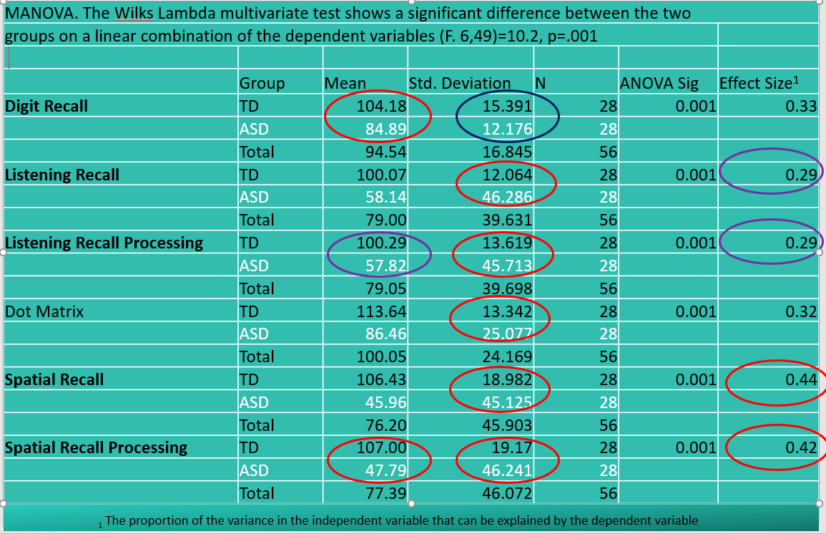
Statistical Summary

Slide 22
Limitations
Small sample size.
Used only 1 measure of working memory with the children who participated.
Useful pilot study into WM abilities with children in Ireland
Demonstrates the need for future research
IQ and behaviour was not measured/recorded.
Future research may focus in on the educational, emotional and behavioural impact on low working memory ability between children with autism who do not have a learning difficulty.
A broader screening study is also required to scope and identify the prevalence of working memory deficits in children with autism.

Slide 23
The impact difficulties in Working Memory will have on children with autism

Slide 24
Working Memory in the Classroom
Children who have difficulties with their working memory will present with the following behaviours:
demonstrate higher levels of task abandonment
they forget instructions
they lose attentional focus during tasks

Slide 25
There is a greater likelihood that children with low working memory ability will measure ‘vulnerable’ in a rating for self-esteem than typically developing peers
Some children with impairments in their working memory may present with behavioural difficulties
Overall the most significant behavioural markers for children with low working memory are ‘inattention’ and ‘forgetting’

Slide 26
Working Memory and Autism
Children with autism (and ADHD) are shown to have impairments in some of their executive functions
Notably impairments in working memory
Research indicates that the task performance of children with autism was negatively correlated with the length of instruction

Slide 27
Research into working memory function and autism demonstrates that children with autism will typically present with low average – impaired working memory
Weakness in visuo-spatial working memory is reported in the majority of studies
Some research has identified strengths in verbal working memory but this is not reported across all research

Slide 28
Middletown’s research found that of the 56 children tested with the AWMA the children with autism did not perform as well as their typically developing peers
This was particularly significant in visuo-spatial working memory

Slide 29
How to Help
Alloway and Gathercole (2008) detail seven steps to help children with working memory impairments in the classroom.

Slide 30
Recognise working memory failures
Failure to follow instructions, task abandonment, place-keeping errors
Monitor the child
Look out for warning signs and ask ‘What are you going to do next?’ or ‘Tell me what you are going to read’
Evaluate working memory loads
Evaluate signs of the above - manage heavy memory-loaded activities and demanding processing activities
Reduce working memory loads

Slide 31
Step | Actions
Recognise working memory failures | Failure to follow instructions, task abandonment, place-keeping errors
Monitor the child | Look out for warning signs and ask ‘What are you going to do next?’ or ‘Tell me what you are going to read’
Evaluate working memory loads | Evaluate signs of the above - manage heavy memory-loaded activities and demanding processing activities
Reduce working memory loads | Reduce information given to child, break instructions into smaller steps, increase meaningfulness and familiarity of material
Repeat important information | Repetition can be supplied by teacher or by learning support or other pupils
Encourage memory aides | Wall charts, memory cards, counters, visual and audio aides
Develop child’s strategies | Asking for help, personal systems involving child’s interests

Slide 32
Keep up to Date with Events at the Centre
Register for our regular Newsletter at:
www.middletownautism.com
Follow us on Twitter @autismcentre
Find Middletown Centre for Autism on Facebook

